Slide 1
www.SMIadviser.org
For patients, families, friends, people who have questions, or people who care for someone with serious mental illness, we offer access to resources and answers from a national network of experts.

Slide 2

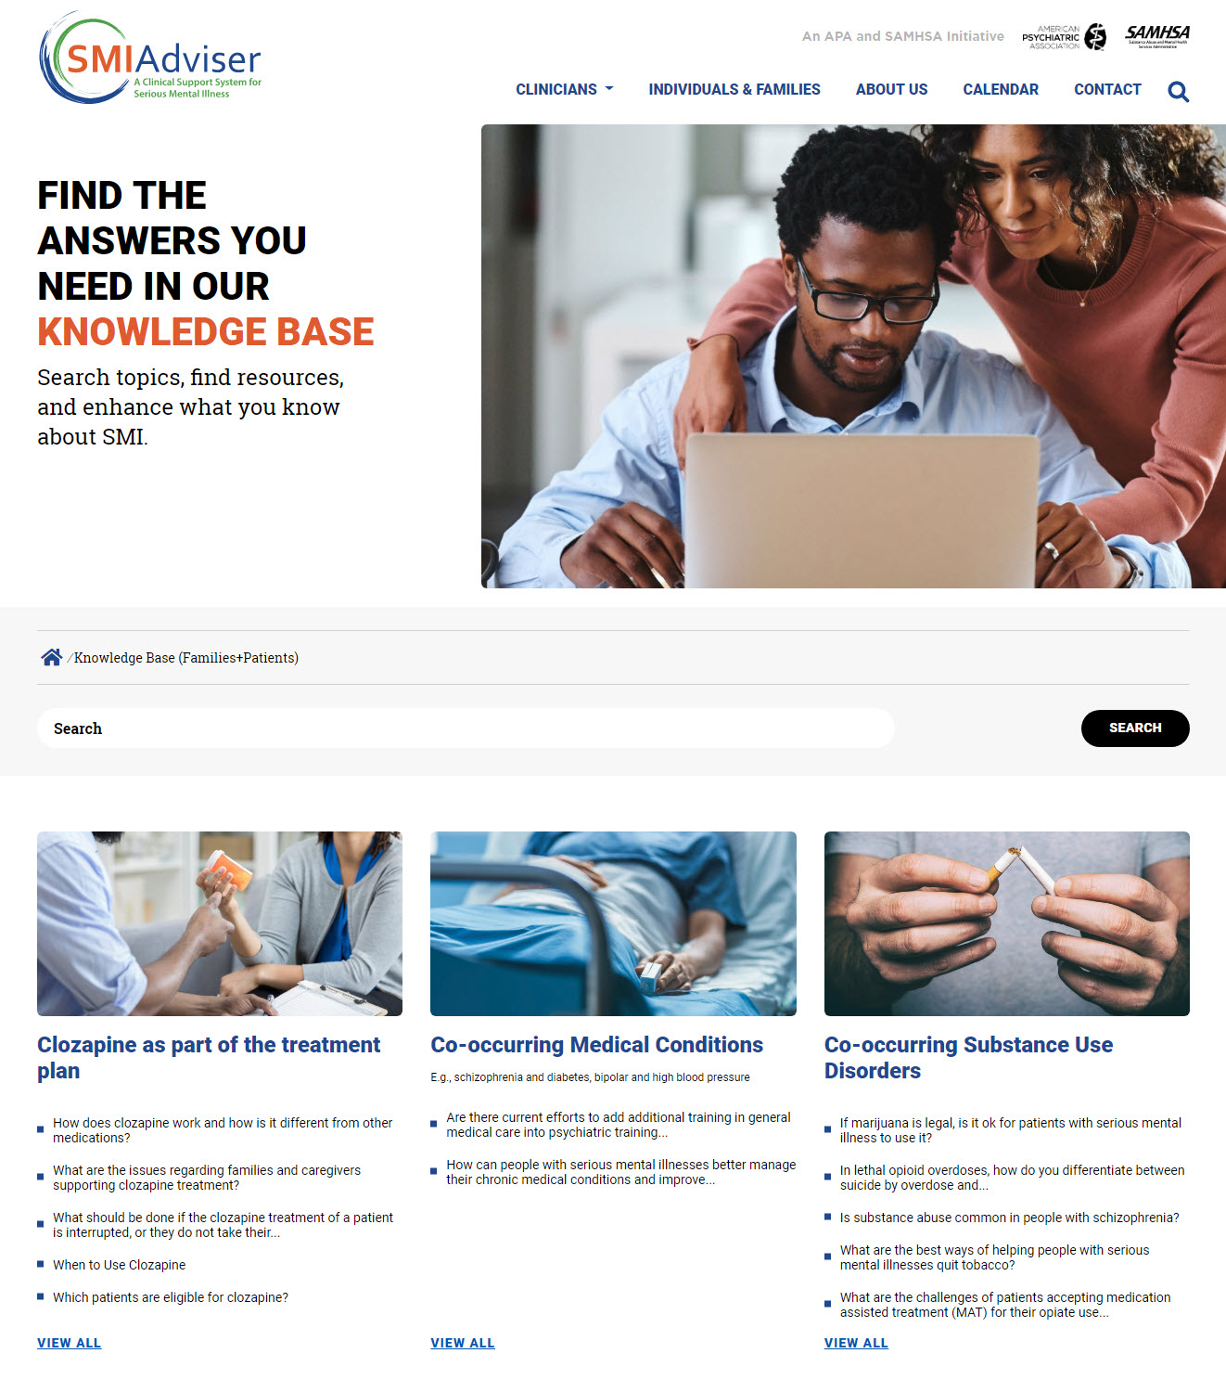
THE SMI ADVISER KNOWLEDGE BASE
Find answers to questions about treatment options.
Find insights about recovery, self-care, and other supports you may need.
Find answers on smartphone apps, telehealth, chatbots and more.

Slide 3
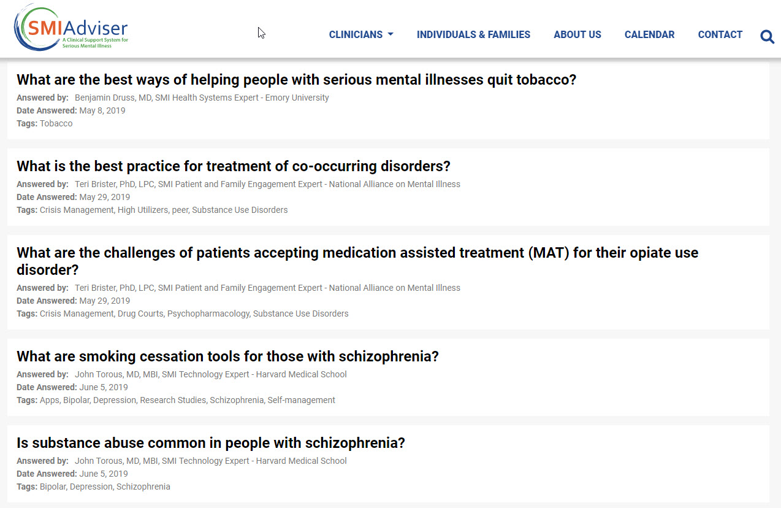
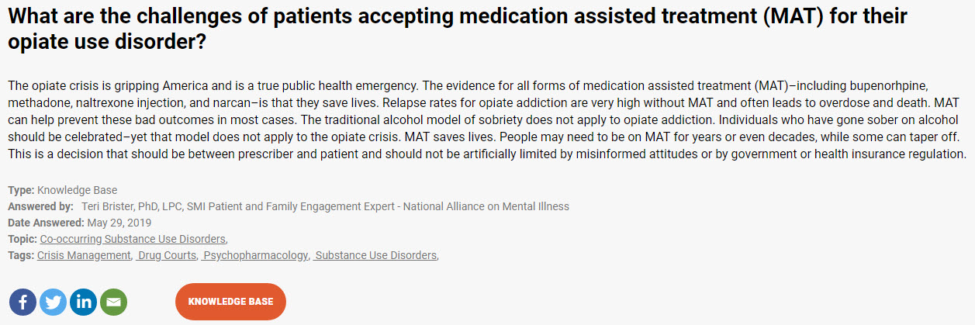
ANSWERS AND RESOURCES FOR INDIVIDUALS AND FAMILIES
1
Go to SMIadviser.org/knowledge-base-fp
2
Browse any subject area, ask a question, or search for a specific topic

Slide 4

























A STRONG PARTNERSHIP NETWORK
Content Experts
Advisory Board / Additional Expertise
Notes:
Note for later - Swap ATTC logo with unified TTC logo (this is in development)

Slide 5
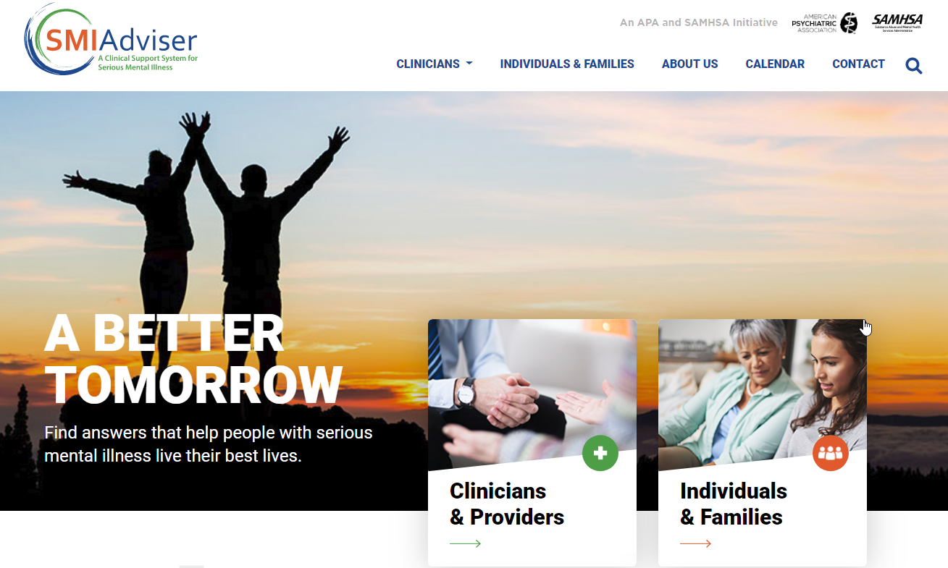
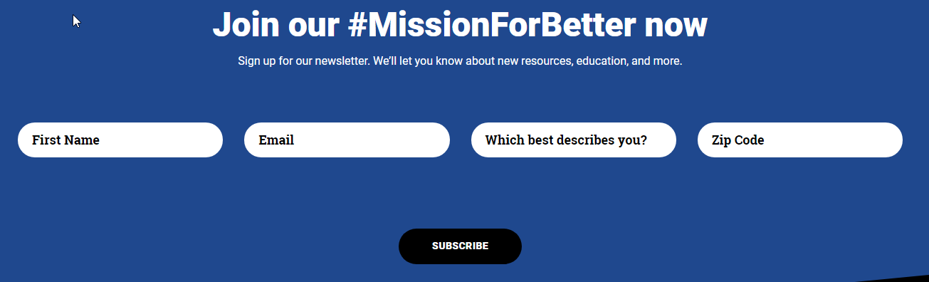
JOIN OUR #MISSIONFORBETTER
Sign up at www.SMIadviser.org
Sign up today!

Slide 6
SMI ADVISER

