Slide 1
PROJECT OVERVIEW

Slide 3


FACTS ABOUT SERIOUS MENTAL ILLNESS
Diagnoses most commonly associated with SMI:
Approximately
1 in 25 (11 million)
adults in the United States lives with a serious mental illness (SMI).
Schizophrenia
Bipolar Disorder
Recurrent Major Depression
A wide range of effective treatments are available, which support recovery and improved quality of life.
Approximately 50% of people with these diagnoses receive treatment.
Pharmacology
Family Support Services
Peer Specialist Services
Assertive Community Treatment
Family Support
Supported Employment
Social Skills Training
Psychoeducation
Cognitive Behavioral Psychotherapies
Early Intervention
Crisis Services

Slide 4
SMI ADVISER MISSION STATEMENT
Our mission is to advance the use of a person-centered approach to care that ensures people who have SMI find the treatment and support they need.
___
For clinicians, we offer access to education, data, and consultations so you can make evidence-based treatment decisions.
___
For patients, families, friends, people who have questions, or people who care for someone with SMI, we offer access to resources and answers from a national network of experts.

Slide 5



MAXIMIZE COLLABORATION TO IMPROVE CARE FOR SMI
INTERPROFESSIONAL TEAM
LIVED EXPERIENCE
SYSTEM LEVELS
Psychiatry
Nursing
Psychology
Peer Support
Social Work
Technology
Marketing
Individuals with SMI
Family Members
Health Systems
Local Govt
State Govt
National Associations
Federal Govt

Slide 6

























A STRONG PARTNERSHIP NETWORK
Content Experts
Advisory Board / Additional Expertise
Notes:
Note for later - Swap ATTC logo with unified TTC logo (this is in development)

Slide 7










SMI ADVISER STRATEGIC APPROACH
Education
Consult
Education
Engagement
Consult
Consultation
Education

Slide 8
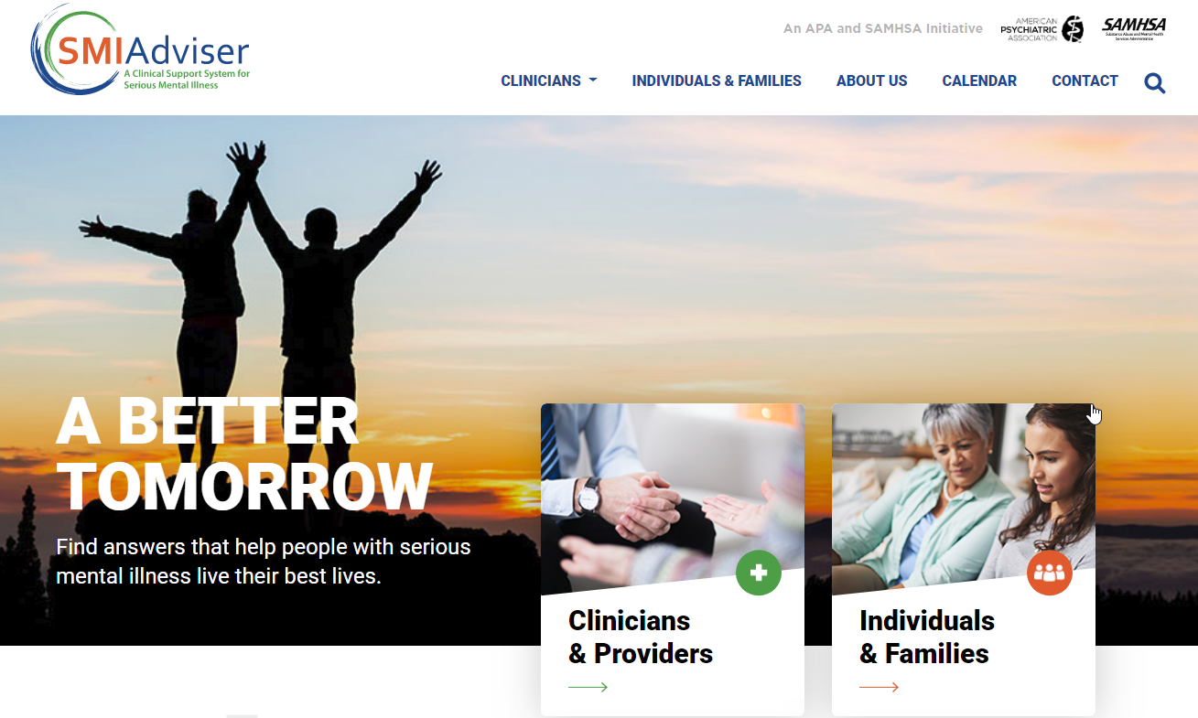

Slide 9

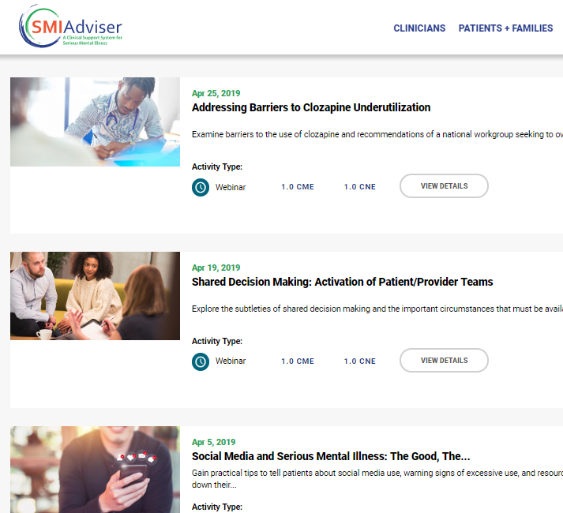
EDUCATION CATALOG
60+ courses currently available.
Courses available as “live” or “on- demand” to meet learner availability
CME/NCPD/CE credits available for physicians, nurses and psychologists
All weekly webinars include live Q&A sessions with our faculty experts
Free educational resources for clinicians

Slide 10
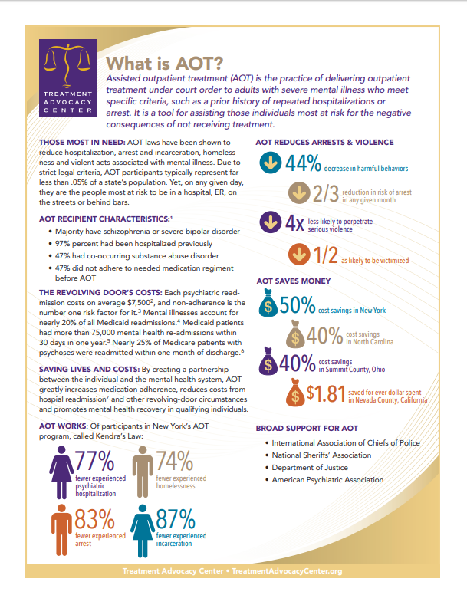
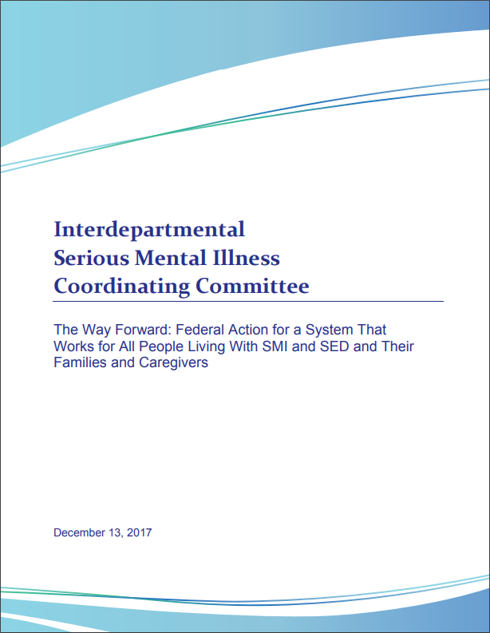
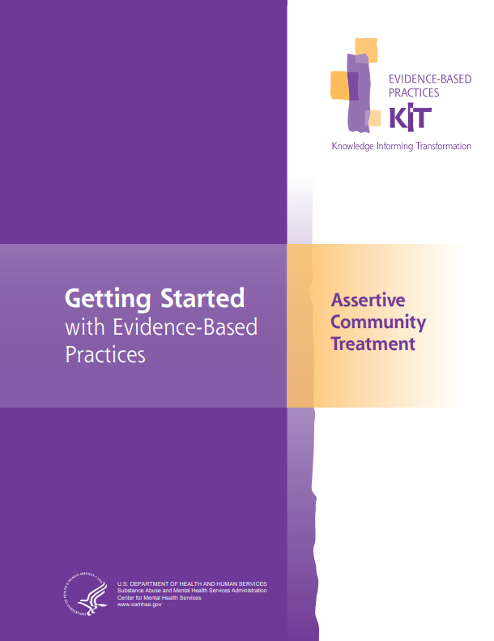

EXPANDING ACCESS TO RESOURCES ON SMI
The inventory of educational resources features both NEW and EXISTING materials

Slide 11
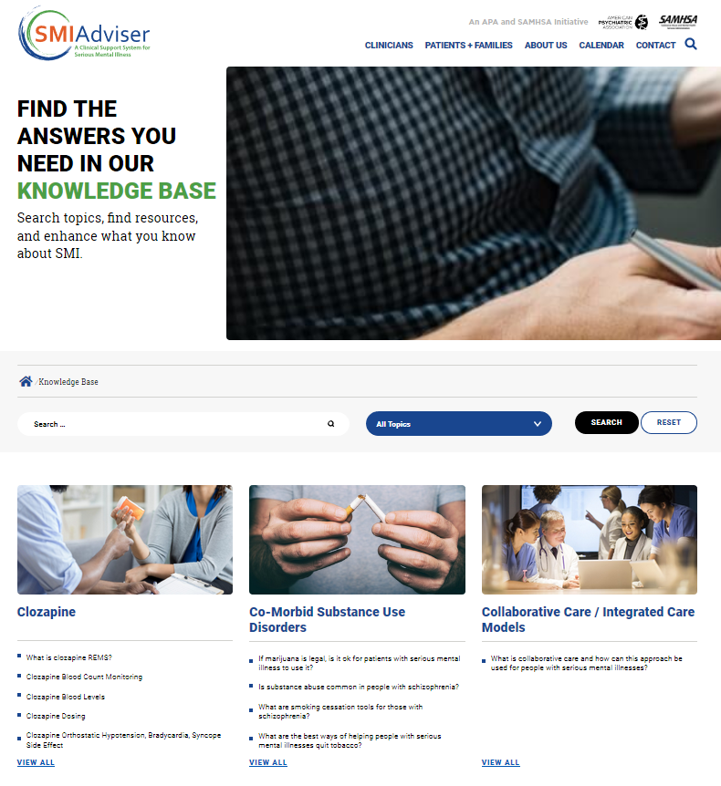
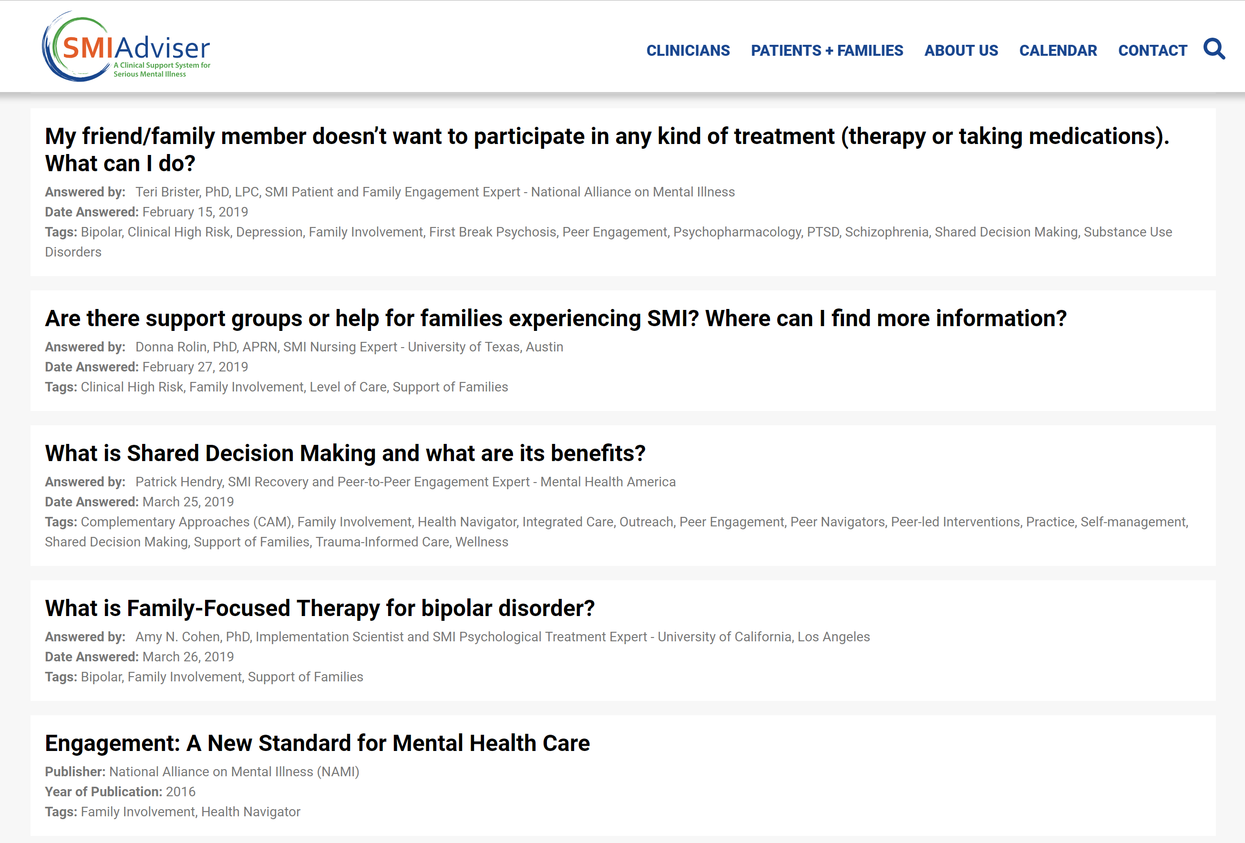
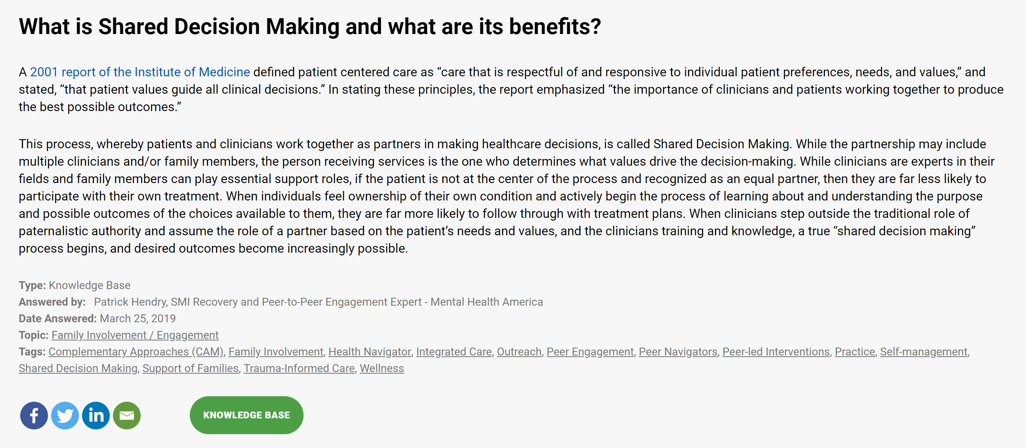
FIND ANSWERS IN OUR KNOWLEDGE BASE
1
Go to SMIadviser.org/knowledge-base
2
Browse any subject area, ask a question, or search for a specific topic

Slide 12
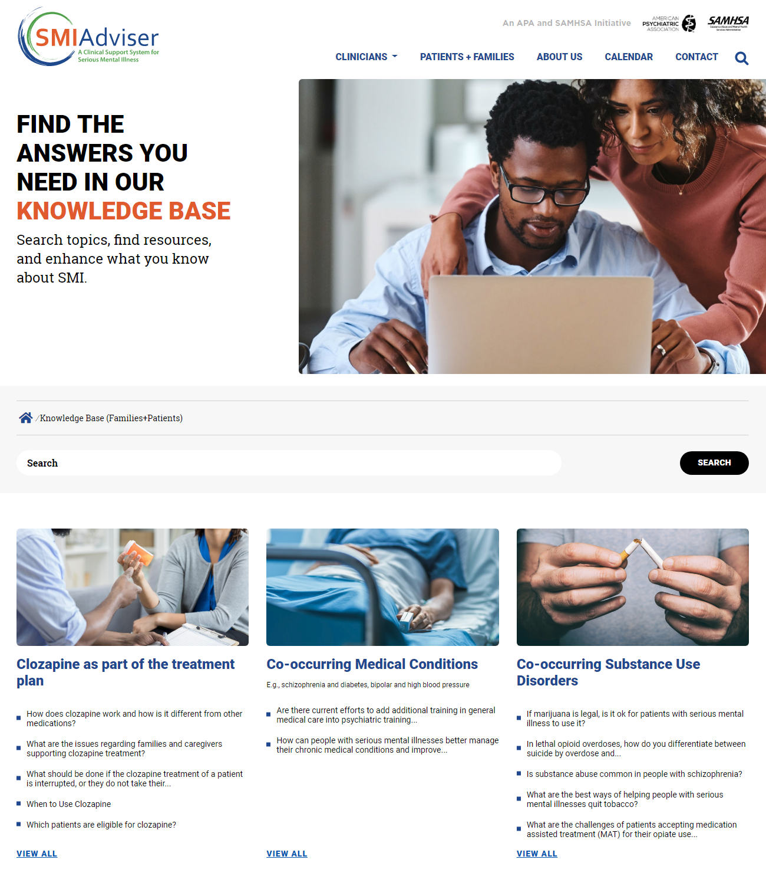
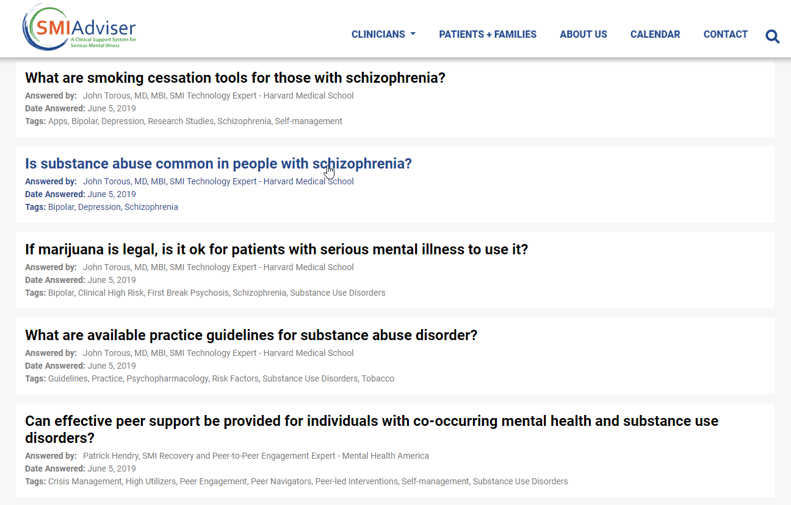
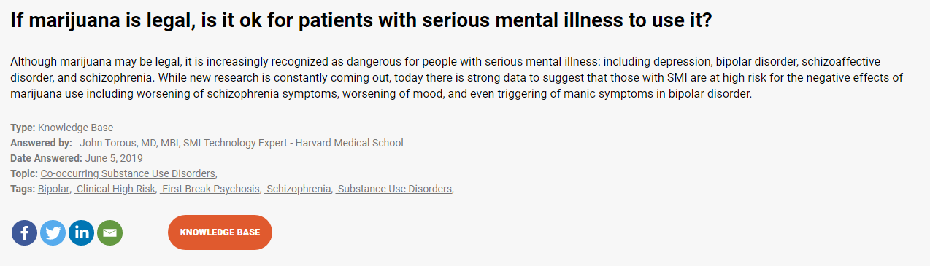
ANSWERS FOR INDIVIDUALS AND FAMILIES
1
Go to SMIadviser.org/knowledge-base-fp
2
Browse any subject area, ask a question, or search for a specific topic

Slide 13
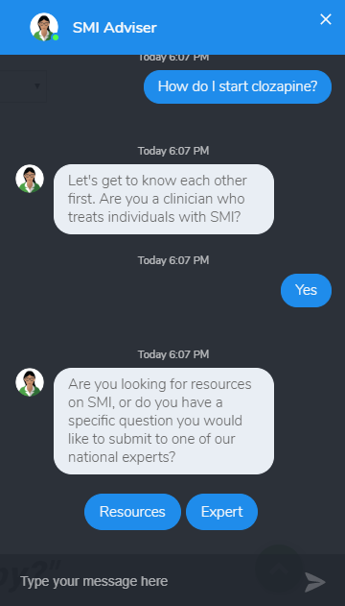
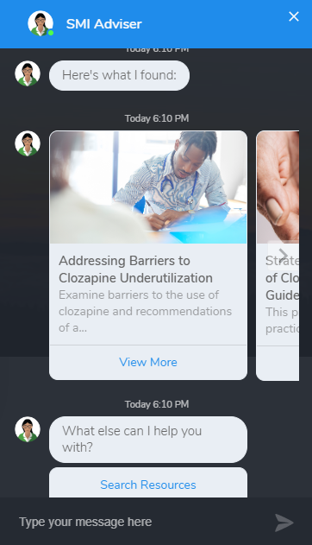
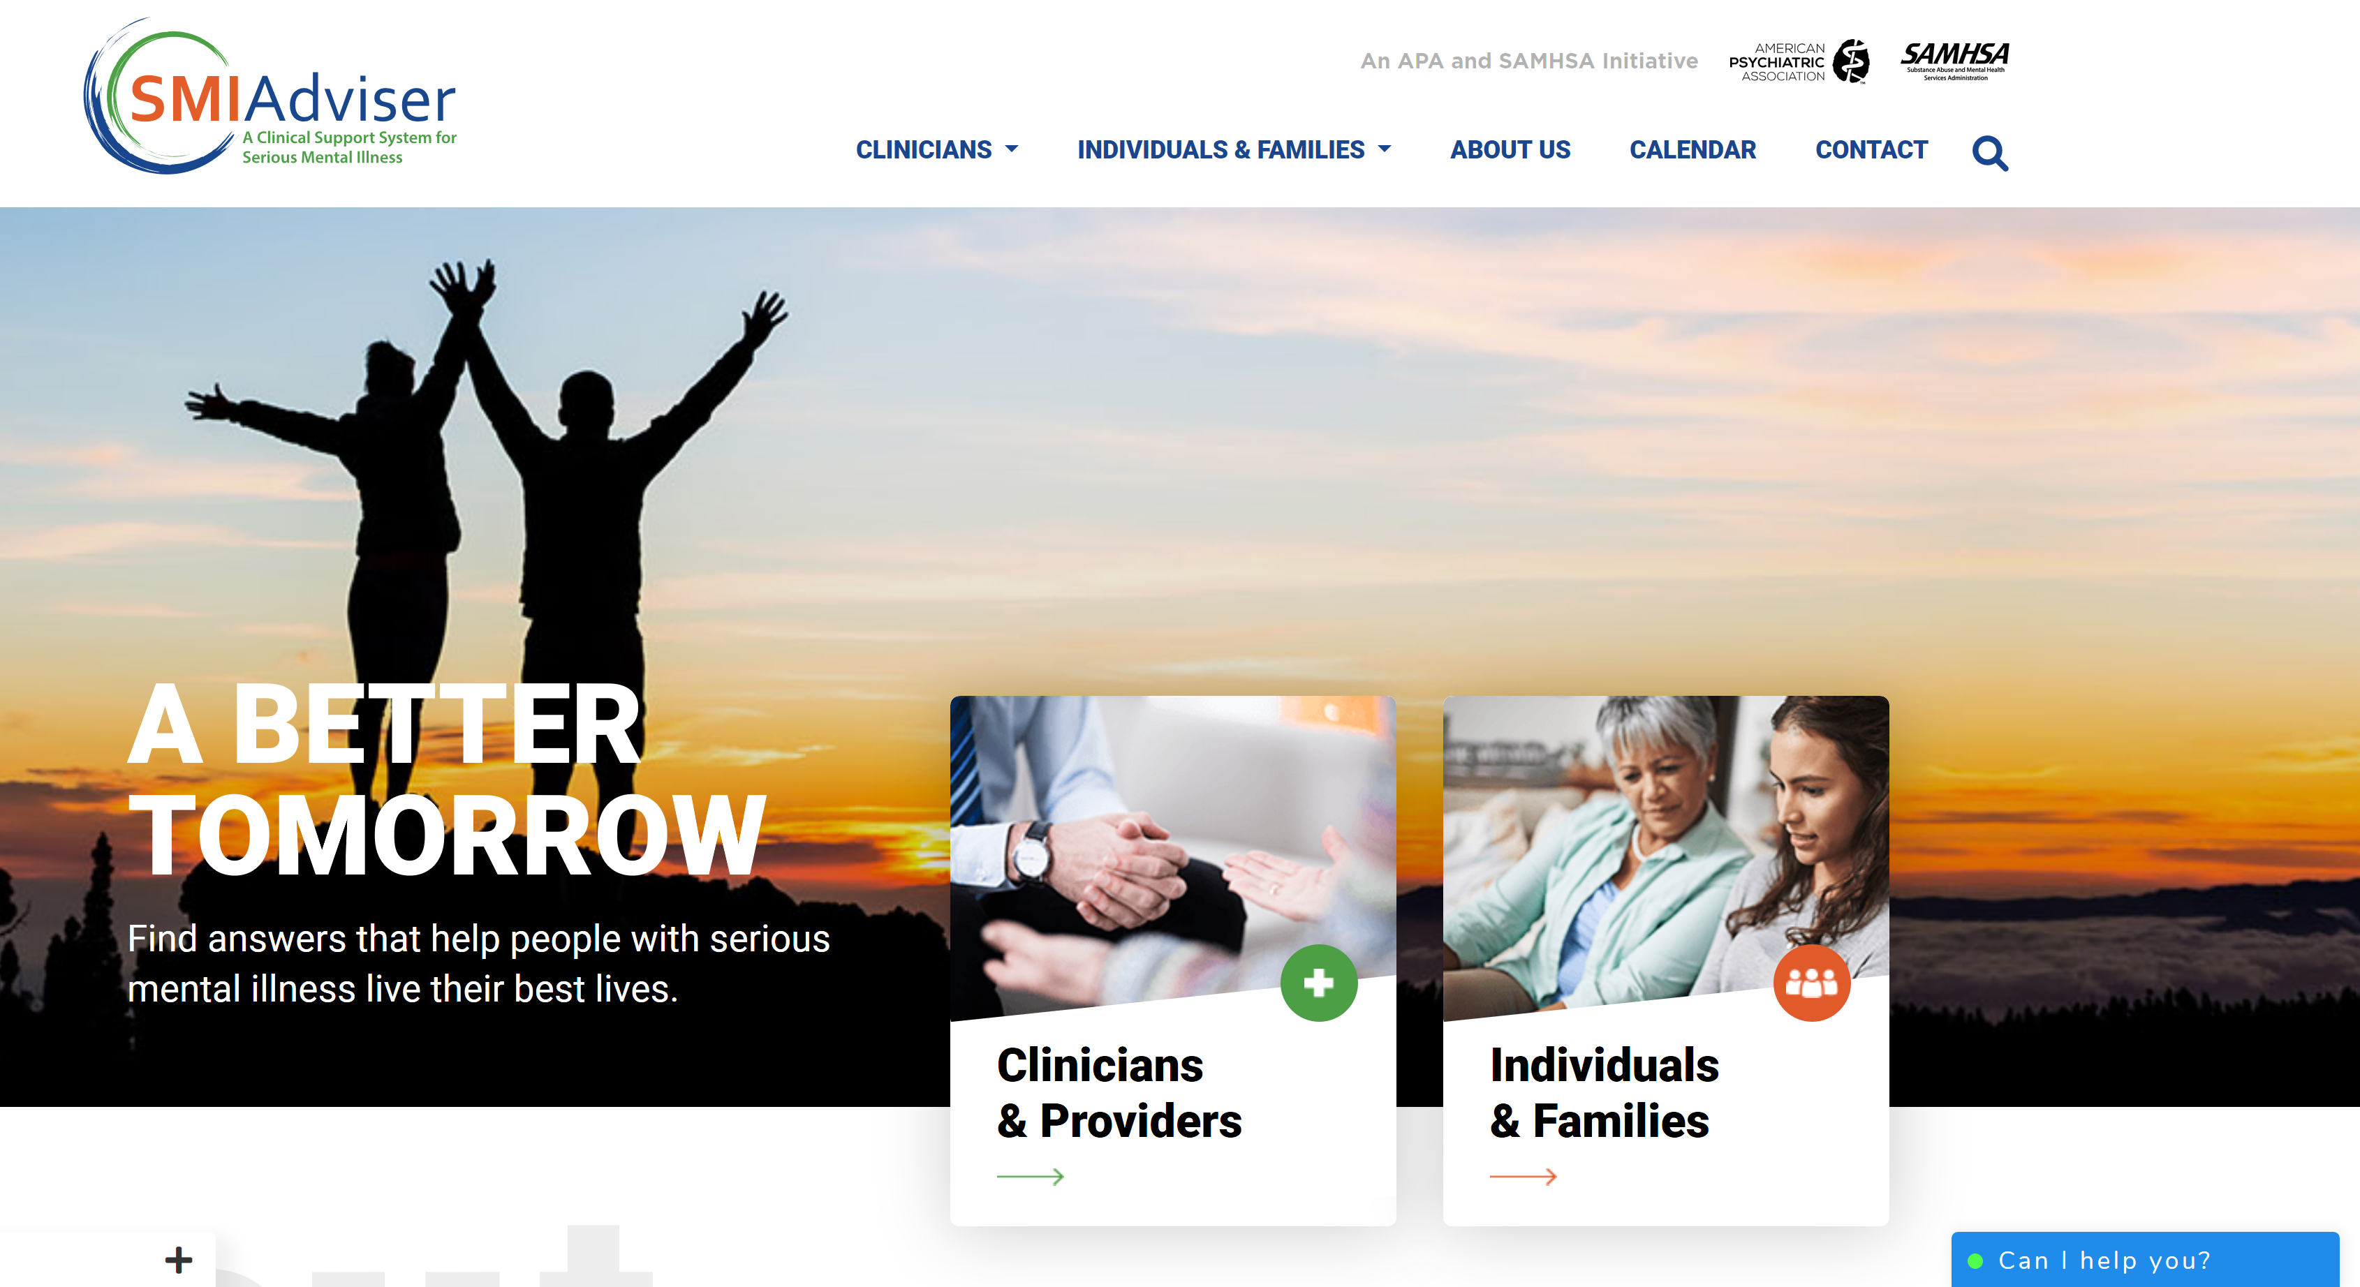
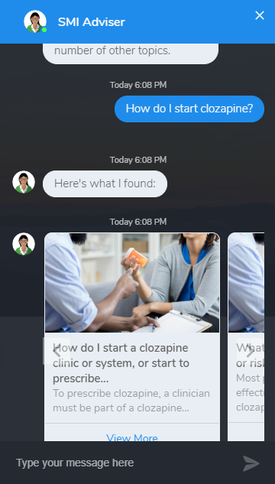
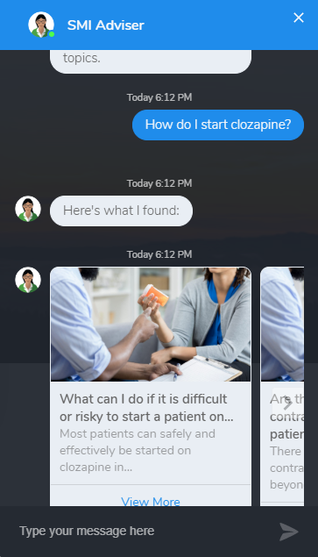
SMI ADVISER CHAT BOT

Slide 14
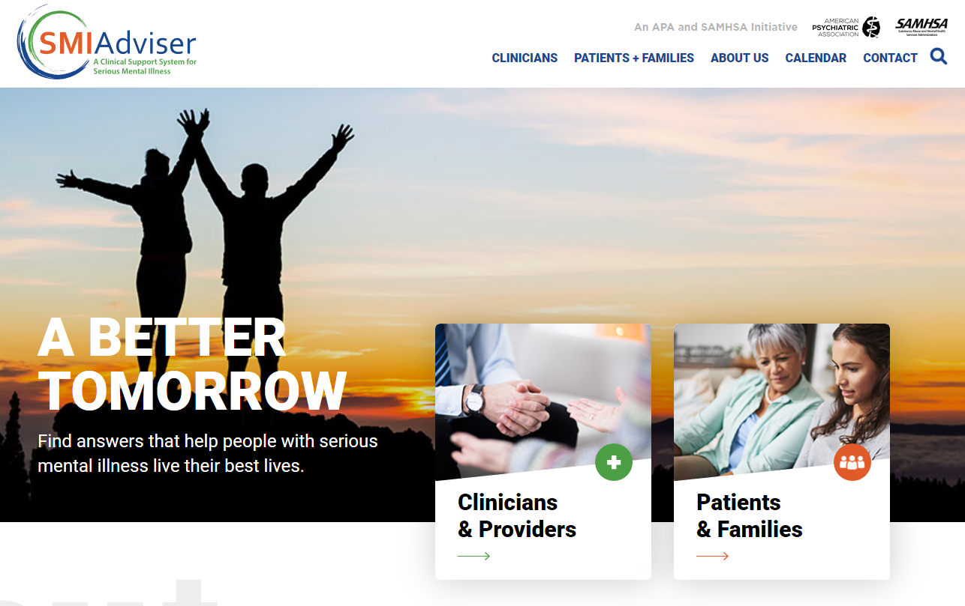

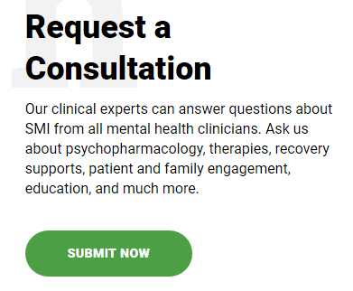
REQUEST A CONSULTATION RIGHT NOW
1
Go to SMIadviser.org/submit-consult
2
Log in or create an account
3
Request a consultation and receive guidance from an SMI expert
Ask us about psychopharmacology, therapies, recovery supports, patient and family engagement, education, and more.

Slide 15
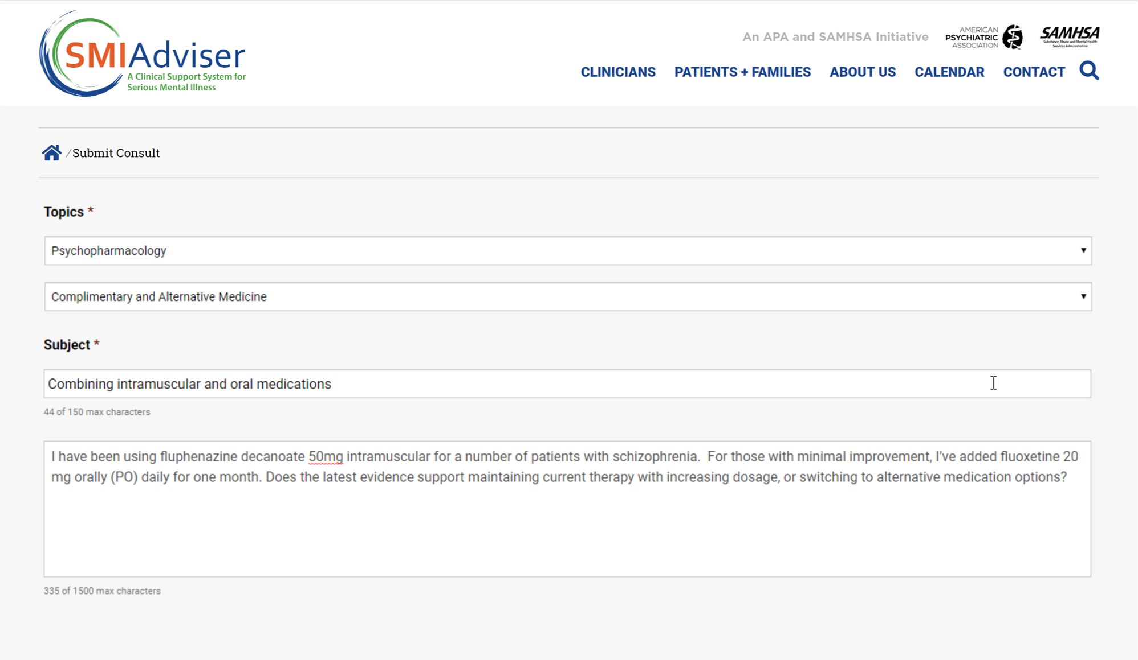
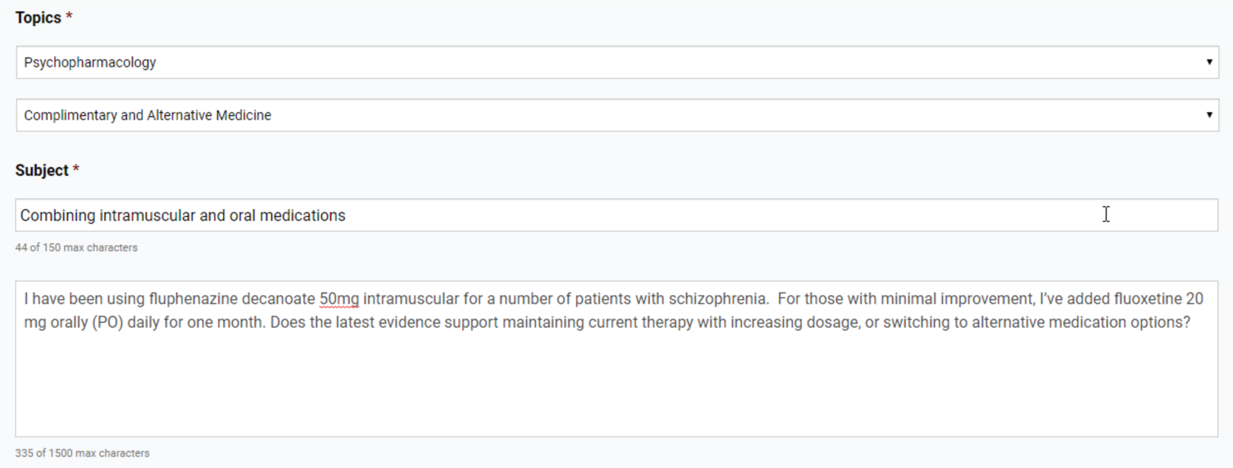
REQUEST A CONSULTATION RIGHT NOW
Our clinical experts can answer questions about SMI from all mental health clinicians.

Slide 16
CONSULTATIONS – CLINICAL EXPERT TEAM
Tristan Gorrindo, MD
  Principal Investigator
  American Psychiatric Association
Amy N. Cohen, PhD
Associate Director
American Psychiatric Association
Teri Brister, PhD, LPC
SMI Patient and Family Engagement Expert
National Alliance on Mental Illness
Ben Druss, MD
Business practices and health system implementation
Emory University
Patrick Hendry
SMI Recovery and Peer-to-Peer Engagement Expert
Mental Health America
Donna Rolin, APRN, PhD
SMI Nursing Expert
University of Texas, Austin
John Torous, MD, MBI
SMI Technology Expert
Harvard Medical School
Joseph Ventura, PhD
SMI Psychologist Expert
University of California, Los Angeles
Alexander S. Young, MD, MSHS
  SMI Physician Expert
  University of California, Los Angeles
Notes:
Patient Engagement - Terri Brister (NAMI)
Business practices – Ben Druss (Emory)
Nursing – Donna Rolin (UT Austin)
Psychiatry – Alex Young (UCLA)
Psychology – Amy Cohen (UCLA)
Recovery Oriented Practice – Patrick Hendry (MHA)
Technology – John Torous (HMS)
* Includes website, areas of highest needs, PsychPRO

Slide 17

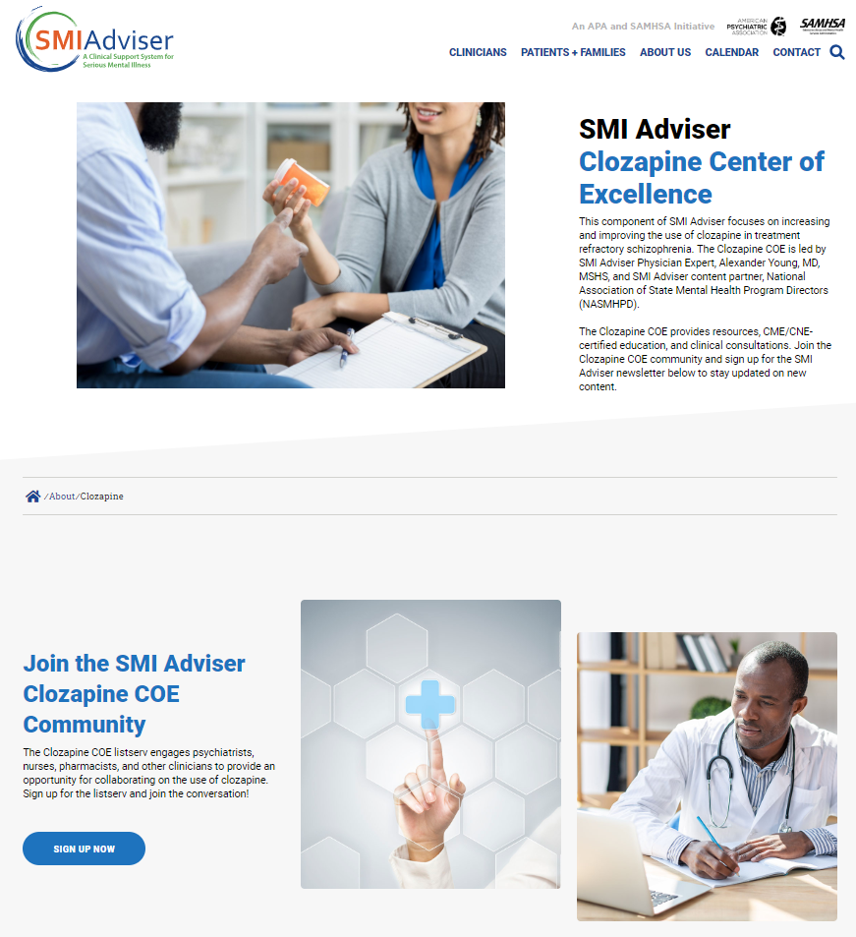
CLOZAPINE CENTER OF EXCELLENCE (COE)
Focused on increasing and improving the use of clozapine in treatment refractory schizophrenia
Led by Alexander Young, MD and NASMHPD
  http://SMIAdviser.org/clozapine
Engage with the clozapine community through the Clozapine COE Listserv
  http://apapsy.ch/clozapine-list

Slide 18
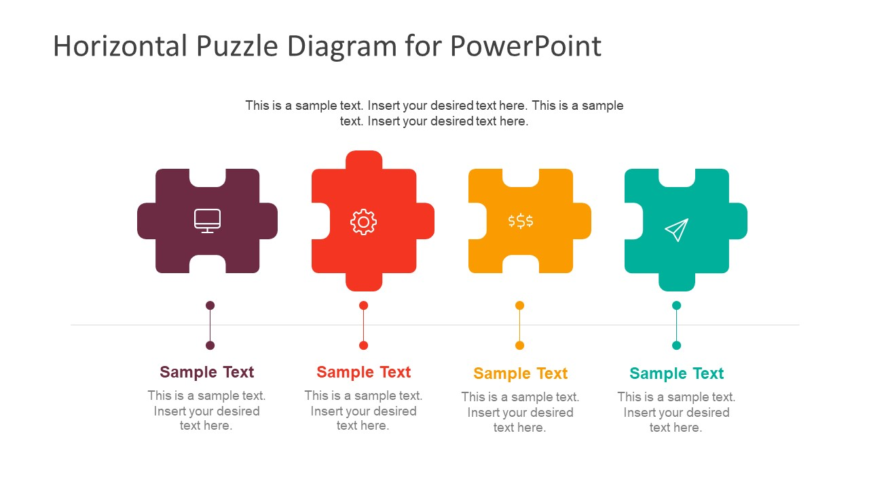





SAMHSA INITIATIVES THAT SUPPORT EVIDENCE-BASED CARE
MHTTC
Mental Health Technology Transfer Center
PTTC
Prevention Technology Transfer Center
ATTC
Addiction Technology Transfer Center
NCEED
National Center of Excellence for Eating Disorders
COE for PHI
Center of Excellence for Protected Health Information
Evidence-Based Practice

Slide 19
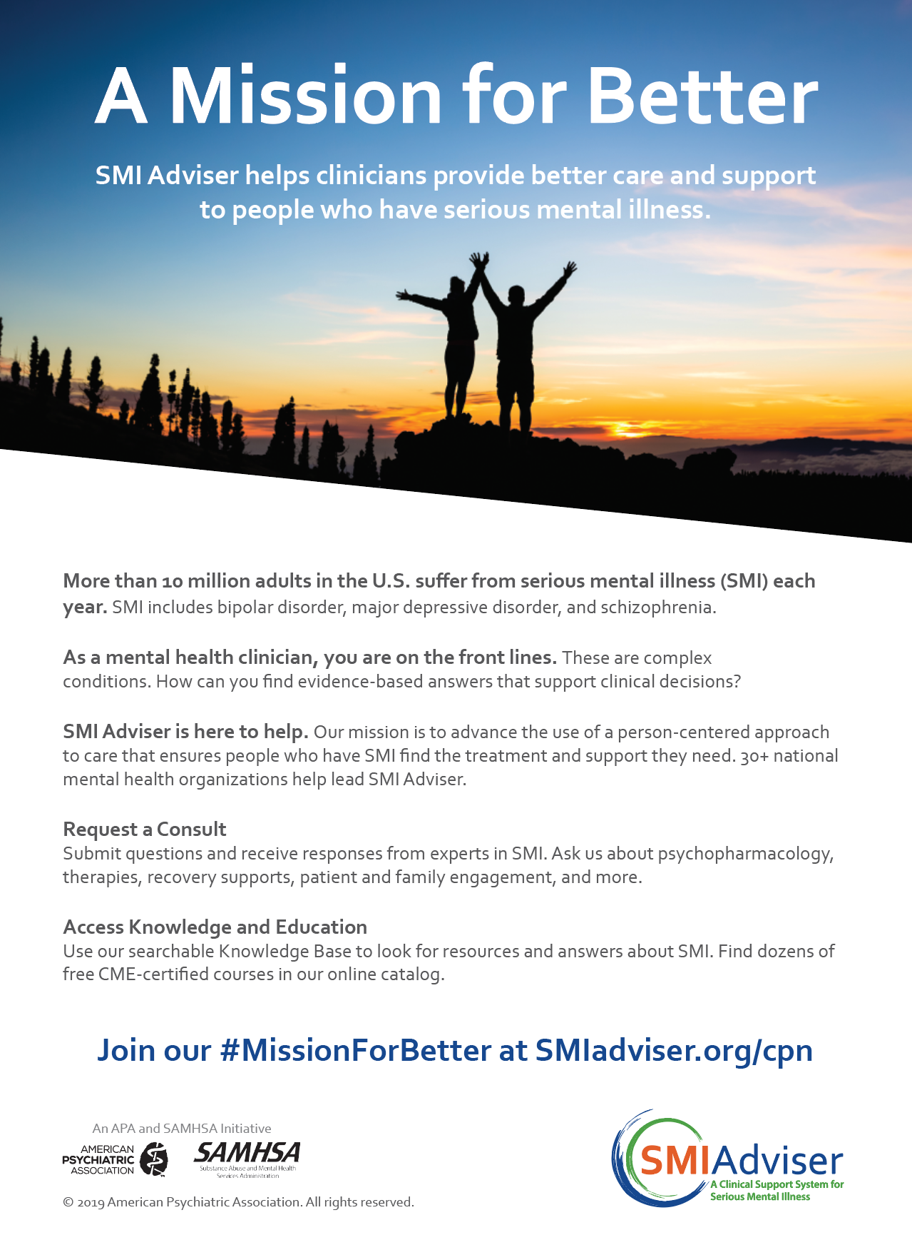
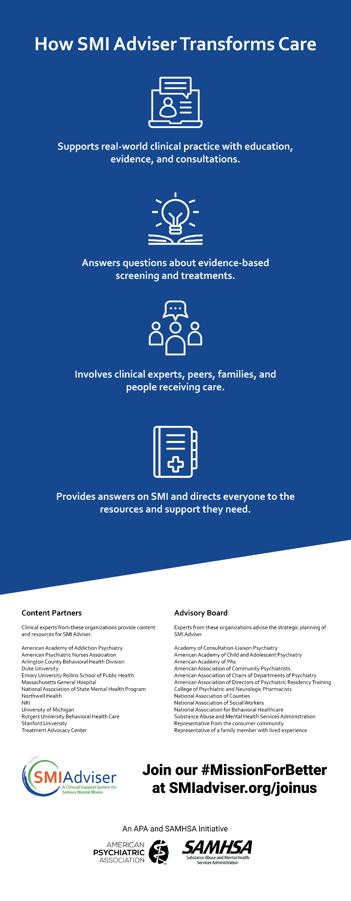
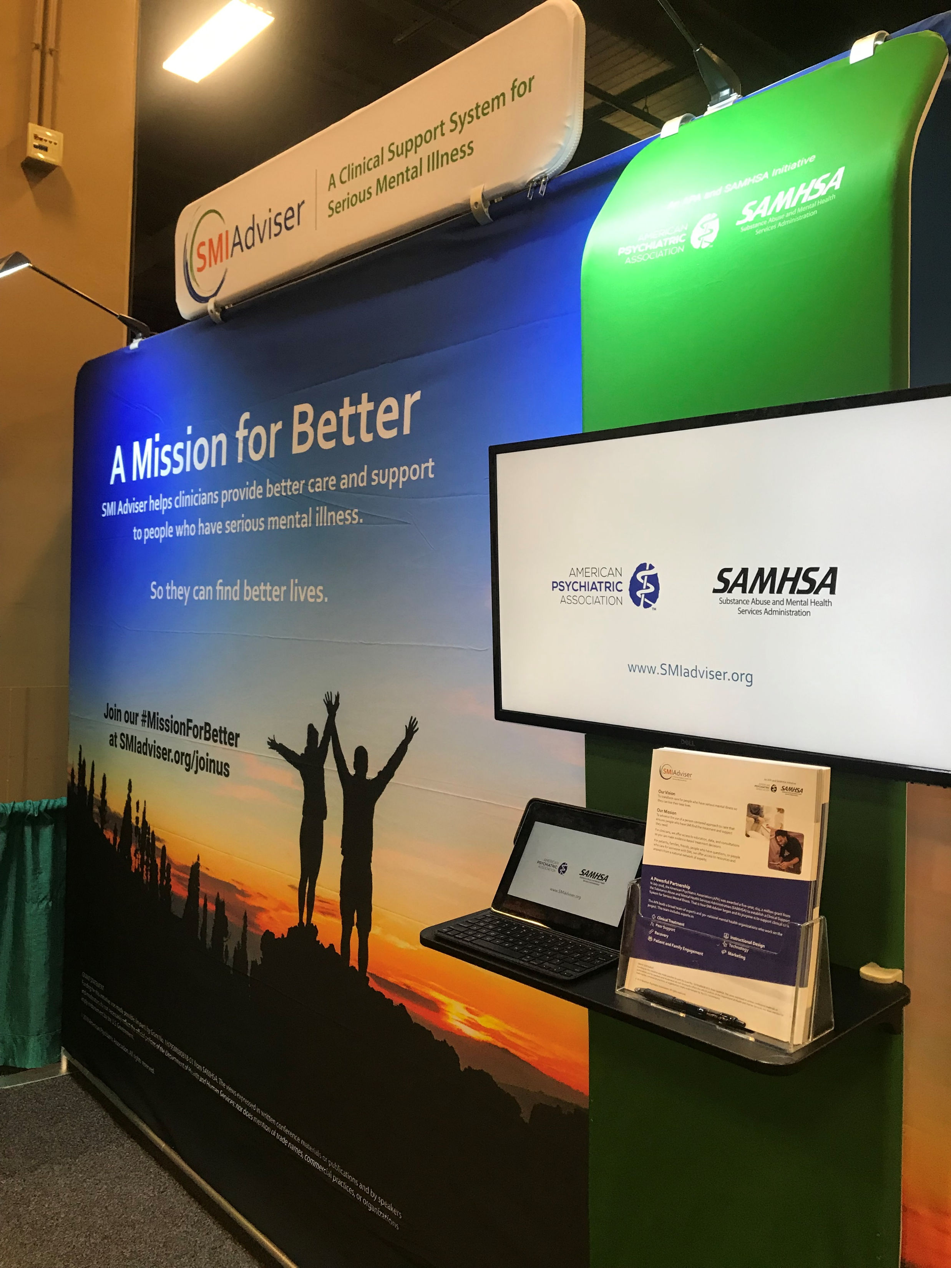
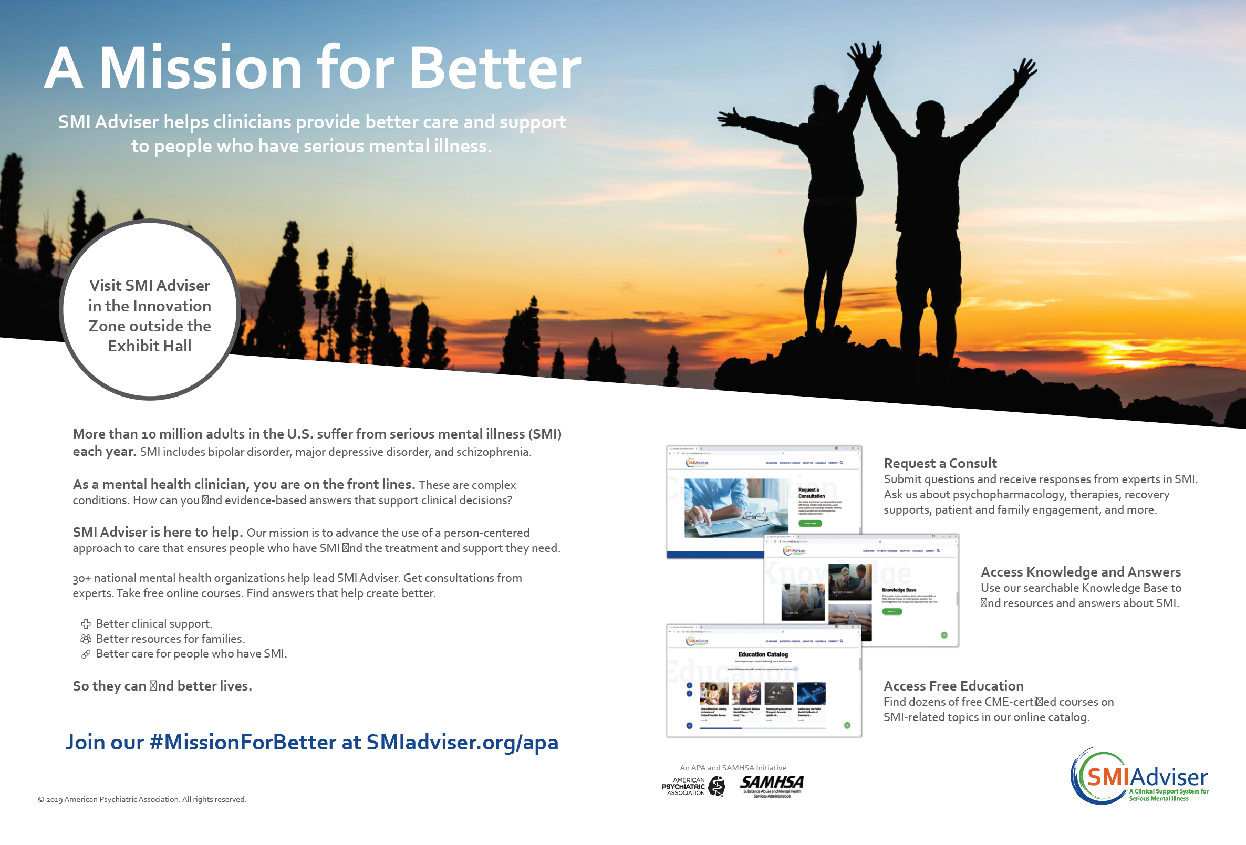
MISSION FOR BETTER
Print Ad
Pull Up Graphic
A national marketing campaign to create awareness and engagement for SMI Adviser
Print Ad Spread
Exhibit Booth

Slide 20
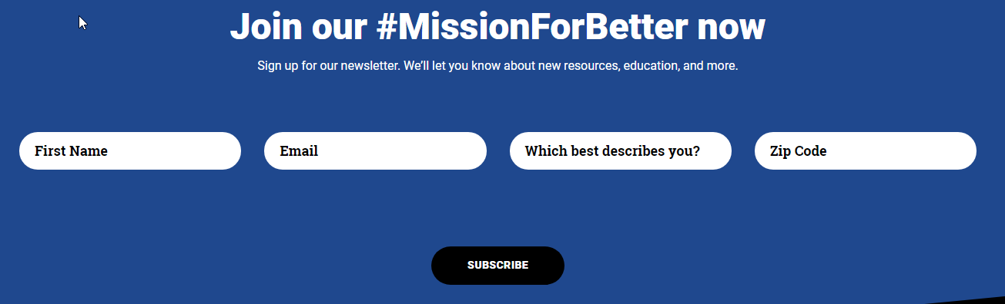
JOIN OUR #MISSIONFORBETTER
Sign up at www.SMIadviser.org
Sign up today!

Slide 21
SMIadviser.org
Tristan Gorrindo, MD
tgorrindo@psych.org
Amy N. Cohen, PhD
acohen@psych.org

